Slide 1
Comparative Analysis of Music Streaming Platforms
TEAM 9
Authors: Akhilesh Tawde, Rishika, Rohit Jain, Raj Phadke

Slide 2
INTRODUCTION
Spotify, Amazon Music, Pandora, & Apple Music allow users to stream music to their devices on demand.
They provide the user, liability to provide positive or negative feedback for songs chosen by the service and based on the feedback, a subsequent selection of songs is recommended back to the user.
On the other hand, Twitter being a social networking service is also important for business looking to expand their social reach. Using tweets, businesses can reach potential customers outside of the scope of normal marketing methodologies.
Google PlayStore is another platform that allows users to download these applications and rate them based on their performance and likeness.

Slide 3
GOALS
1. Identify & Tag Sentiment for Amazon Music, Apple Music, Pandora and Spotify using Twitter and Google PlayStore reviews
2. Based on user Sentiments, storyline a Comparative Analysis between these platforms
3. Recommend new users with the best application based on their preferences
4. Generate a sentiment report on freshly mined twitter data for analysis

Slide 4
IMPLEMENTATION TASKS
Scrape Data
Tag Sentiments
Train & Deploy Model(s)
Generate Timely Reports
Storyline Comparative Analysis
Deploy Web-app to evaluate outcomes

Slide 5
SCRAPE DATA
For Twitter:
- Use the TweePy API class that provides access to the entire twitter RESTful API methods. Each method accepts various parameters and returns responses
For Google PlayStore:
- Fetch and Extract data by web scraping.
- The process involves downloading a page, crawling through multiple pages and extracting data
- Using Beautiful Soup and Selenium Web Driver

Slide 6
TAG SENTIMENTS
VADER to Tag Sentiments:
- VADER stands for Valence Aware Dictionary and sEntiment Reasoner
- It is “especially” attuned to sentiments expressed in Social Media
- It is a rule-based Lexicon analysis tool that uses a combination of sentiment lexicons which are a list of features (words) labelled according to their semantic orientation
- They are either tagged as Positive, Negative or Neutral with a degree of how positive or negative a sentiment is.

Slide 7
VADER (continued)
VADER key points:
- Punctuations: The use of exclamation marks(!) affect the magnitude of intensity keeping the semantic orientation of text intact
- Capitalization: The use of upper case letters emphasizes a sentiment and increases the magnitude of sentiment intensity
- Degree Modifiers: Also called intensifiers, they impact the sentiment intensity by either increasing or decreasing the intensity.
- Other Parameters such as Conjunctions, Preceding Tri-Grams, Emojis, Slangs and Emoticons affect the overall sentiment magnitude

Slide 8
TRAINING AND DEPLOYING MODELS
VADER provides us with a dataset with Tagged Sentiments (Good, Bad, Neutral)
We utilize this dataset to deploy Supervised Machine Learning Model(s) to predict the Sentiment outcomes for freshly mined Data
Models Trained:
Logistic Regression
Support Vector Machine
Random Forest Classifier
Bagging
Boosting
Naïve Bayes

Slide 9
BEST MODEL
Best Model:
- Support Vector Machine
Word Vectorization
- Word-Level TF-IDF (Unigram)
Hyperparameters After Tuning:
- C = 1.0, degree = 3, gamma = 0.001 & kernel = ‘linear’
Test Accuracy --> 88.80%

Slide 10
DEPLOYING A WEB-APP
Deployed a Web-Application using Heroku and Flask to predict the sentiment outcomes for freshly mined Data
The Web App contains 4 Sections:
Home Page
Sentiment Report Tab
Recommendation Tab
Analytics Tab

Slide 11
HOW DOES THE WEB APP WORK ?
The Web App contains Multiple Custom Support API’s running on the background
Once the user makes a selection, an AJAX call is made to the respective API with the provided inputs
We fetch the pickled model and use it to classify the provided inputs
The model passes the classification output in the form of a JSON object in the same AJAX call made to the Web App
The Web App renders this output and displays results accordingly
Link : https://sentiment-analysis-music.herokuapp.com/

Slide 12
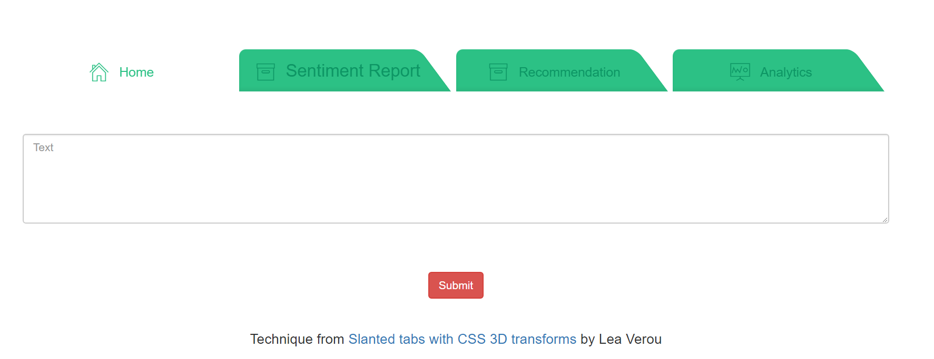
WEB APP HOME PAGE
The Home page contains an Input Text Field in which the user can input a Comment or Review.
On pressing the Submit button, the web-app will render an output based on the Sentiment Classified by the Model Backend

Slide 13
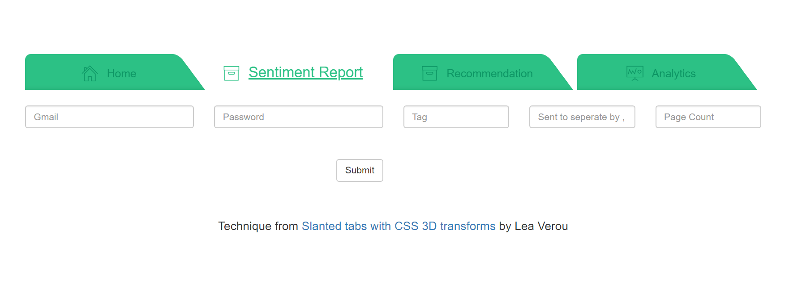
WEB APP SENTIMENT REPORT
In this tab, the user is validated by the Web App to be authentic based on their Email Address Credentials
The user can then search for a specific “Hash-Tag” word in the Tag text field
The “sent-to” text field should contain the destination email address on which the report should be sent
The page count text field specifies the number of pages of report that should be generated

Slide 14
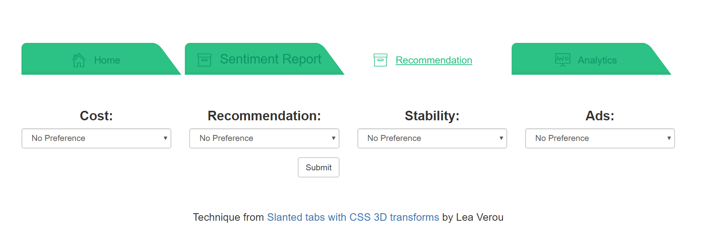
WEB APP RECOMMENDATIONS
The Recommendations tab asks the user for App Related inputs such as Cost, Other’s Recommendation, Stability and Advertisements
The users are free to toggle between the parameters of their choice such as Cost Expensive or Cheap, Ads or No ads etc.
Based on these choices, the web-app will recommend the best Music Streaming App back to the user

Slide 15
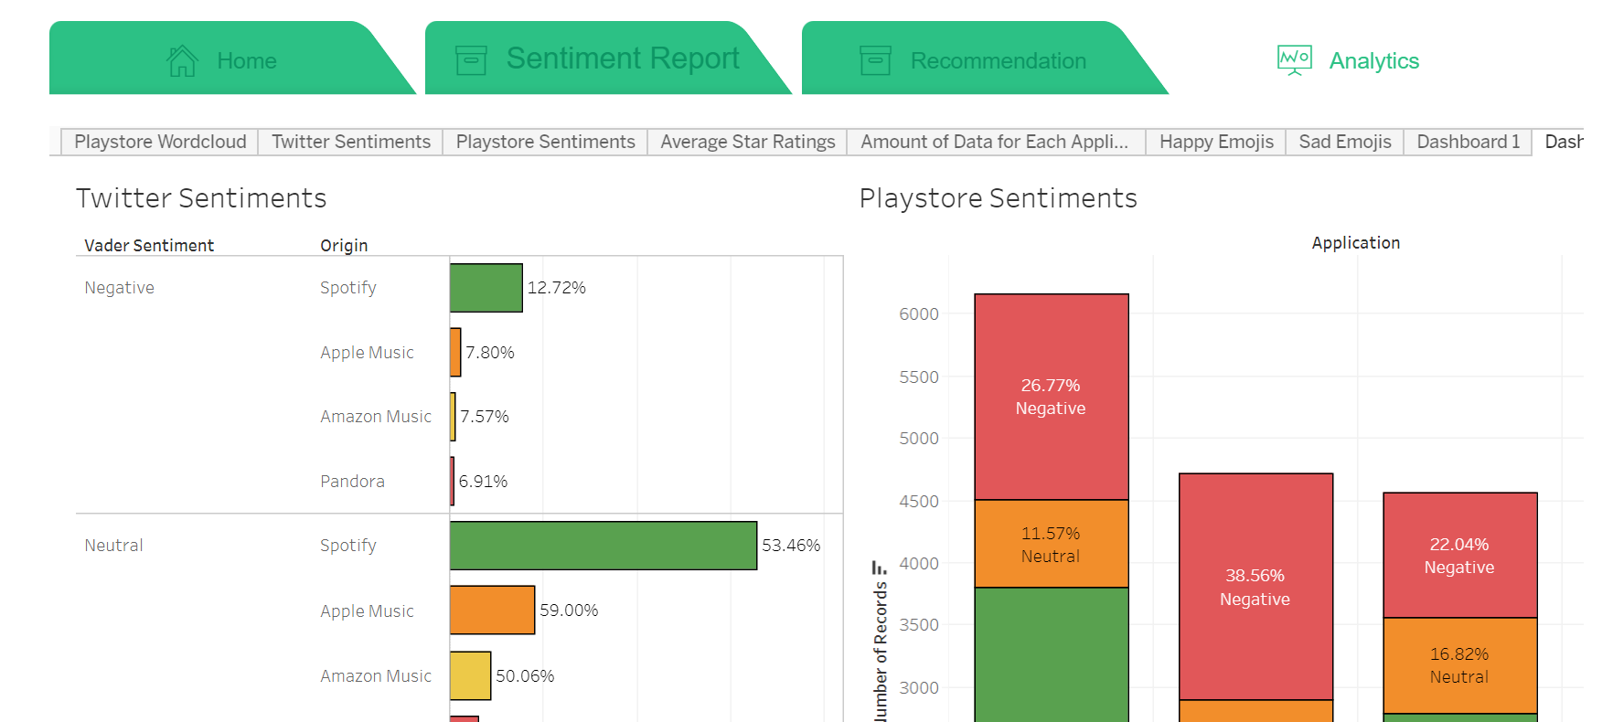
WEB APP ANALYSIS
The Analysis tab contains various visualizations that storyline an overall comparison between these Music Streaming Applications

Slide 16
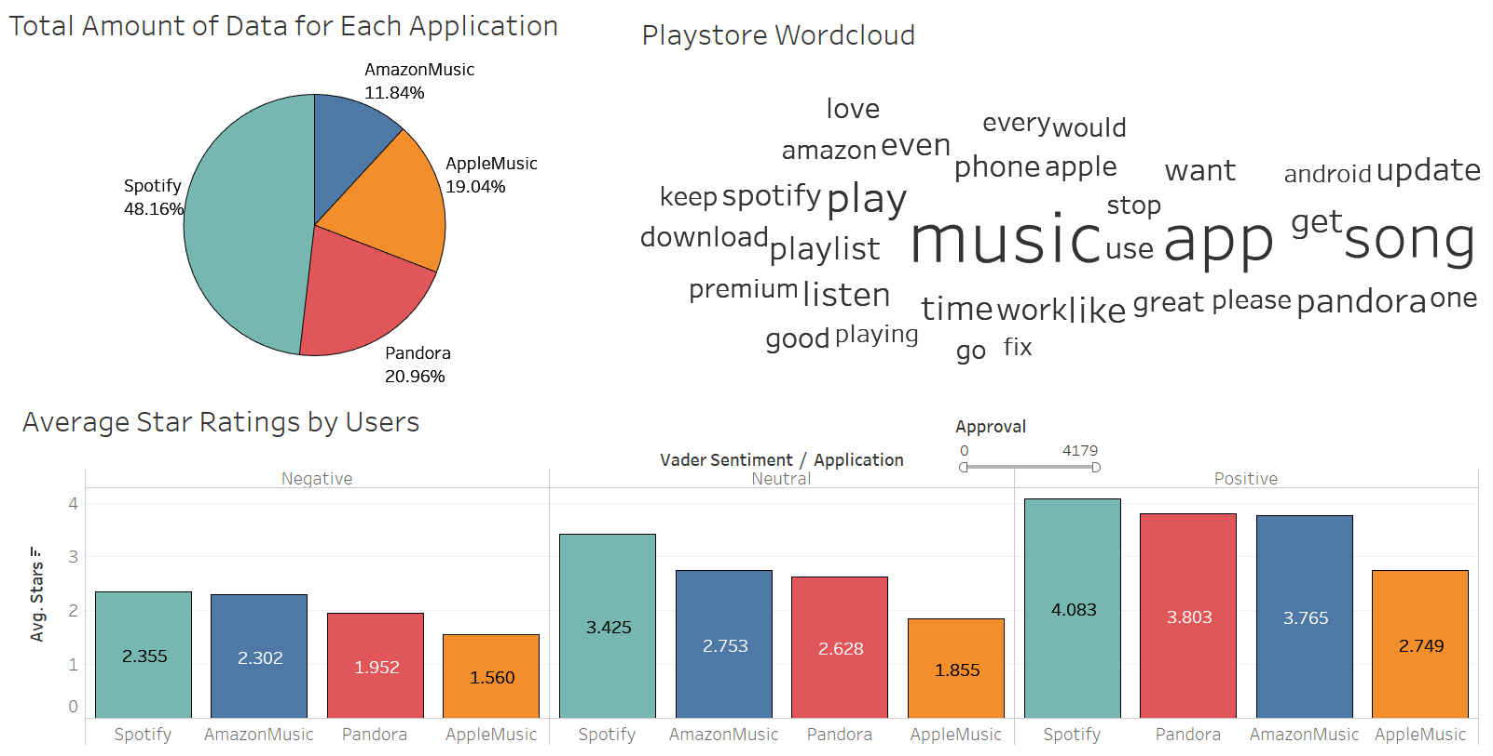
ANALYSIS
Dashboard 1:
Pie Chart Representing the Total Amount of Data for the respective Apps
WordCloud of the most used words in PlayStore Reviews for these Apps
Stacked Bar Chart representing the Average Number of Star ratings on PlayStore filtered by Approvals

Slide 17
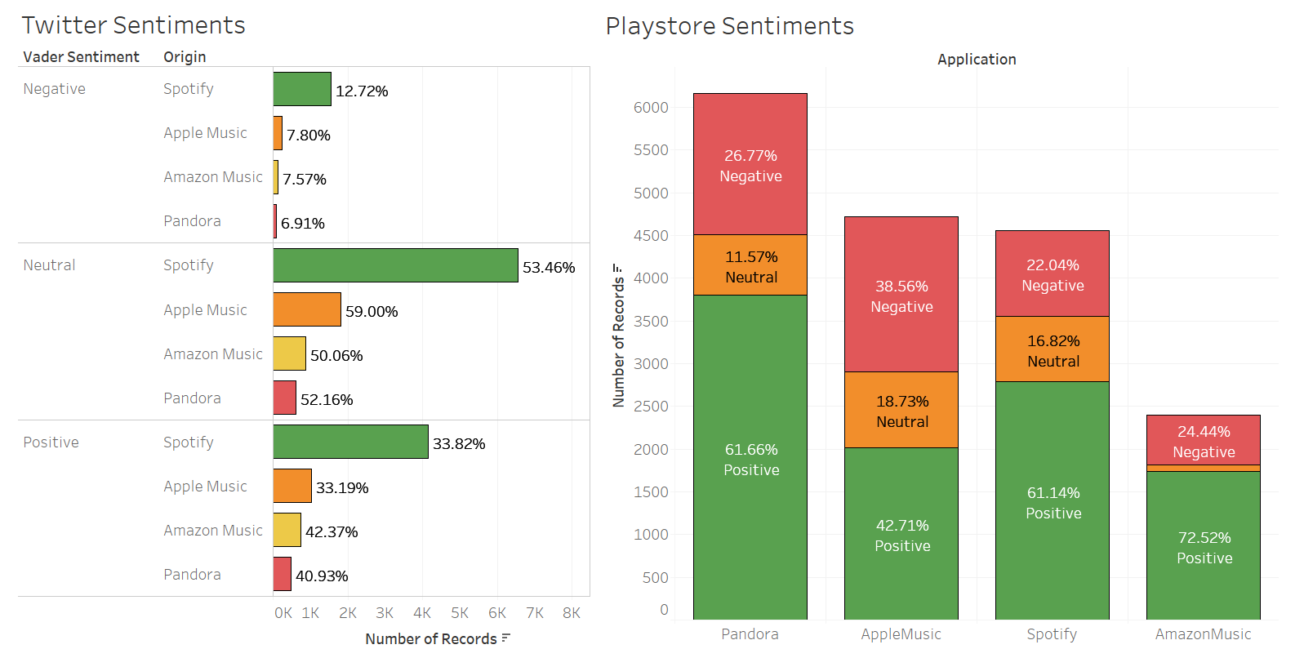
ANALYSIS
Dashboard 2:
Twitter VADER Sentiments
PlayStore VADER Sentiments

Slide 18
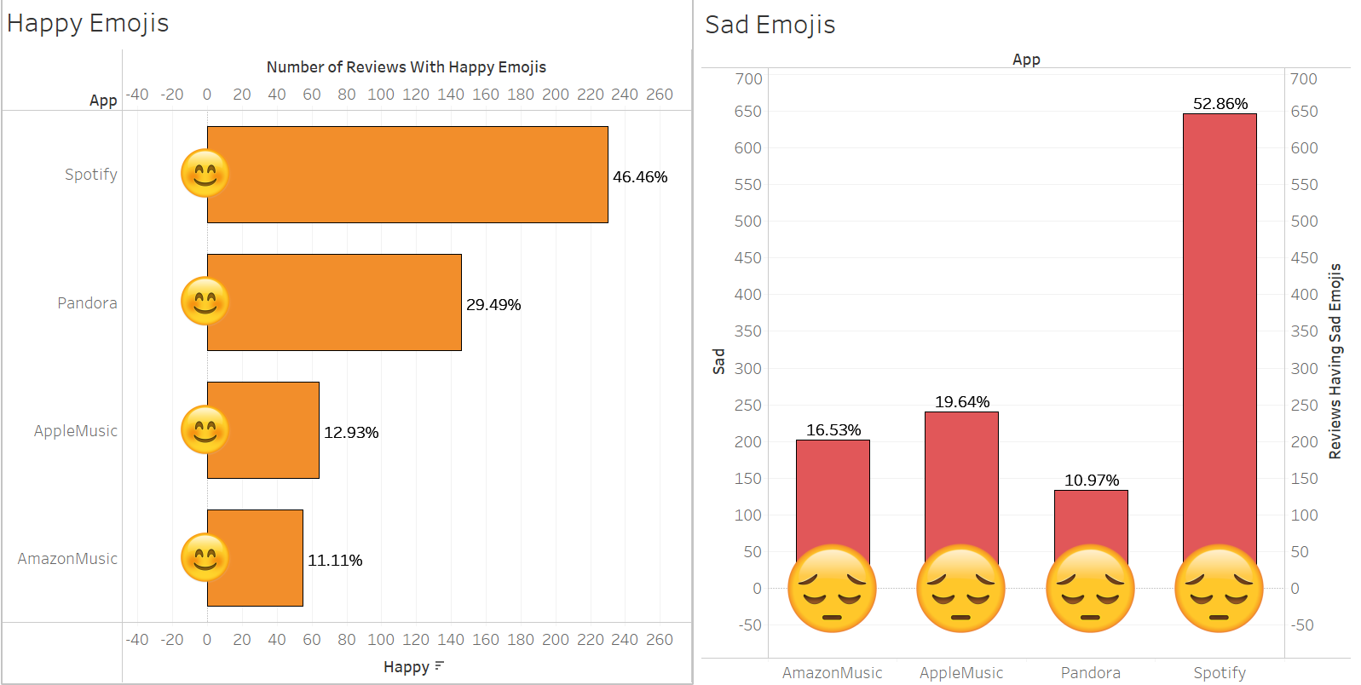
ANALYSIS
Dashboard 3:
Happy Emoticon Analysis
Sad Emoticon Analysis

Slide 19
CONCLUSION
The overall Project Implementation can be used to satisfy the needs of both, the Users & the Businesses running these Music Platforms
Users can use this project to get a feedback/recommendation on which Music Streaming Application should they vouch for, based on their specific needs of Cost, Stability & in-app Advertisements
Businesses can use this project to analyze the Sentiments of Users using their applications.
Businesses can generate reports using the Web-app to identify which specific “Hash Tags” have the users used the most, closely relating to their application.
Businesses can also get an idea of their potential customers using these reports and on the other hand, which customers to target so as to improve the overall Performance.

